Slide 1
Title : Workforce Administration Solution
Presented by:
Sivakkumaran P
Devadharshini M
Rinisha G
Tamilvanan V M
Jelin Ranjitha K
710021104707
710021104006
710021104023
710021104314
710021104709

Slide 2
Agenda
Introduction
Project Description
Objectives
Project flow
Key Features
Technical Highlights
Benefits
Use Cases
Implementations Workflow
Milestones Achieved
Output
Conclusion

Slide 3
Introduction
What is Workforce Administration Solution?
A comprehensive platform designed to manage employees, projects, and organizational assets effectively.
Built on Salesforce to leverage cloud capabilities and ensure secure, scalable, and efficient operations.

Slide 4
Project Description
Workforce Administration Solution is a software application or platform designed to streamline and automate various aspects of employee’s working on projects and Asset Assignment processes within an organization. It serves as a centralized system for managing employee data, number of projects an employee is working on, tracking employee performance, and keeping record for the assets which they are assigned to.

Slide 5
Objectives
Centralize data management for employees, projects, and assets.
1
Automate repetitive administrative tasks.
2
Enhance data security and ensure compliance.
3
Improve productivity and resource allocation.
4
Facilitate collaboration and streamline workflows.
5

Slide 6
Project flow
Salesforce Account Creation and Verification
Object Creation
Tabs
Lightning App
Setting OWD
User Adoption
Import Data
Profiles
Roles
Users
Page Layout
Chatter Group
Record Types
Permission Sets
Reports and Dashboards
Approval Process
Apex trigger and Validation

Slide 7
Key Features
Employee Management: Track employee data, performance, and project assignments.
Project Tracking: Monitor ongoing and completed projects, assign tasks, and review progress.
Asset Management: Maintain detailed records of assigned organizational assets.
Advanced Security: Implement data encryption, backups, and access control.
Collaboration Tools: Leverage Salesforce Chatter groups for team communication.

Slide 8
Technical Highlights
Built on Salesforce:
Cloud-based solution offering scalability and security.
Data modeling and custom objects for tailored organizational needs.
Features Implemented:
Custom tabs, page layouts, and reports for intuitive navigation.
Role and profile management for secure data access.
Dashboards for real-time data visualization.

Slide 9
Benefits
Efficiency: Automated processes reduce manual effort and errors.
Data Integrity: Secure data storage and compliance.
Scalability: Adaptable to organizational growth.
User-Friendly: Intuitive interface and collaboration tools.
Actionable Insights: Reports and dashboards for informed decision-making.

Slide 10
Use Cases
Employee Management: Simplify tracking and assignments.
Approval Workflows: Streamline leave requests and task approvals.
Project Oversight: Real-time progress tracking.
Data Import: Easy integration of legacy data using CSV files.

Slide 11
Implementation Workflow
Data Modeling: Create objects, fields, and relationships for organizational data.
Security Configuration: Define roles, profiles, and permissions.
Page Layouts: Organize data entry forms for different user groups.
Reporting and Dashboards: Generate actionable insights.
Chatter Integration: Enable team collaboration.

Slide 12
Milestones Achieved
Data model structure for employees, projects, and assets.
Real-time progress tracking using dashboards and reports.
Automated workflows for approvals and task assignments.
Secure data access with role and profile-based permissions.

Slide 13
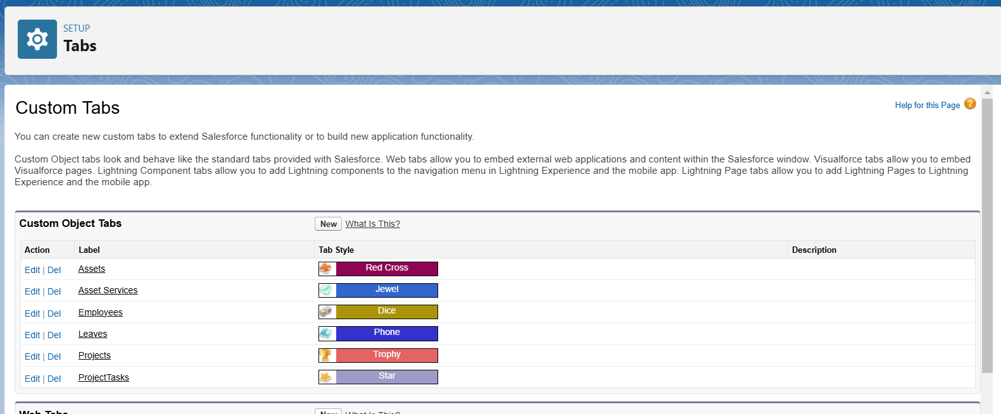
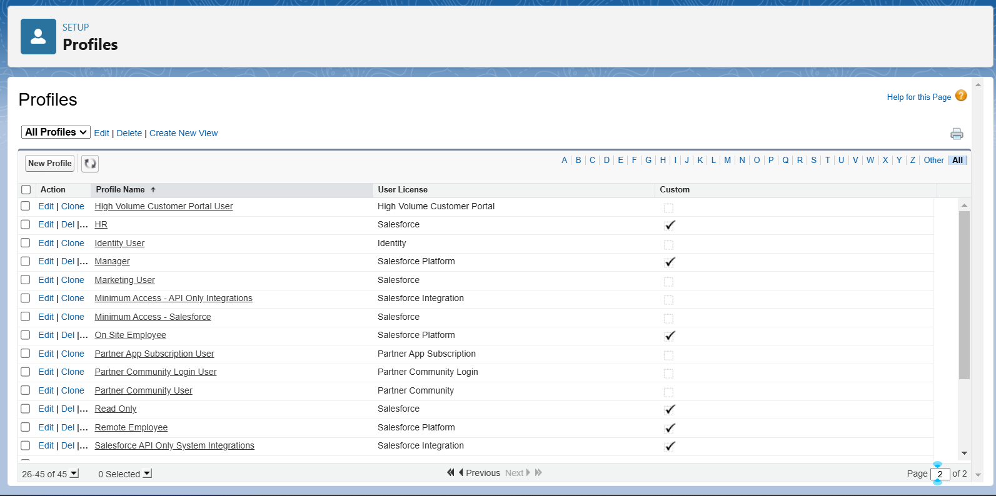
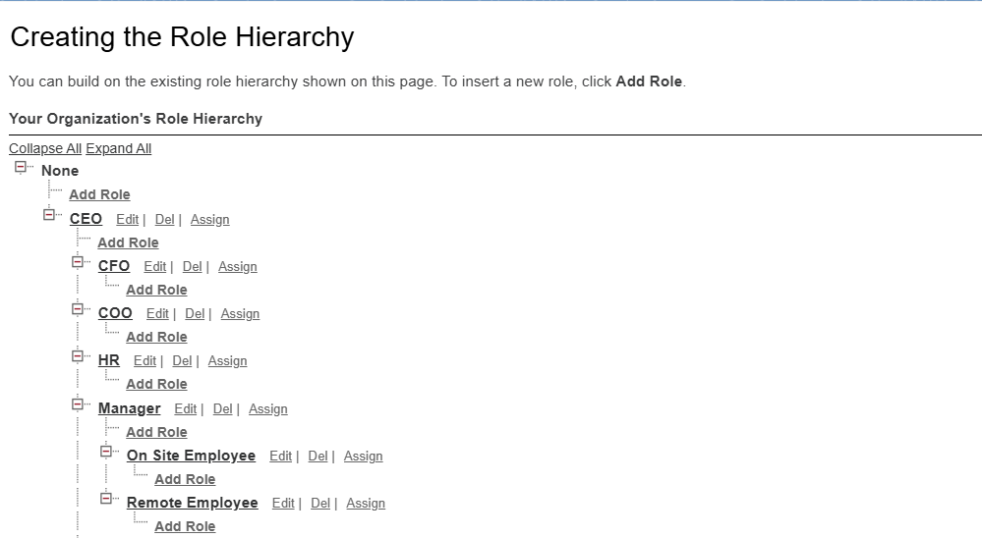
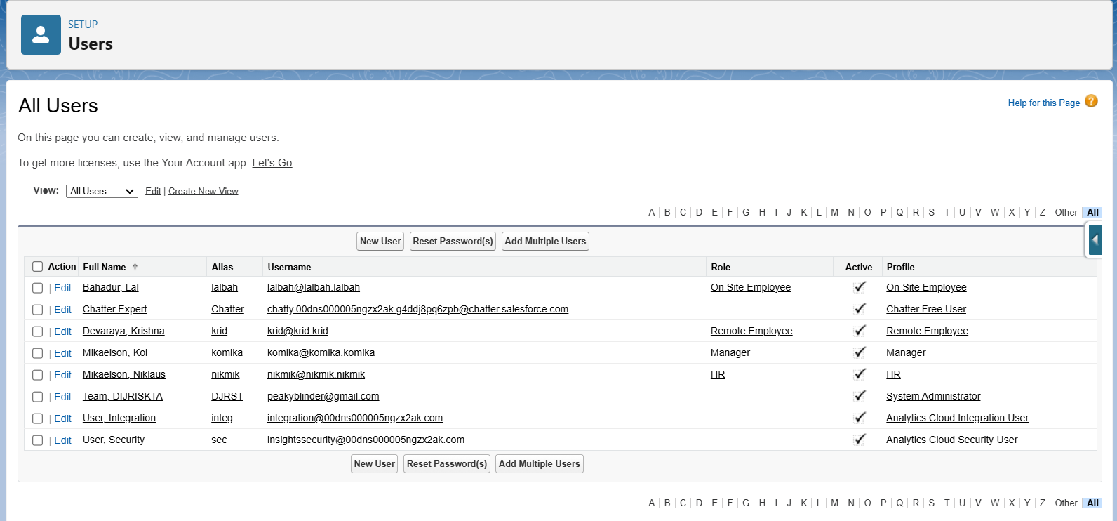
Tabs
Profiles
Roles
Users

Slide 14
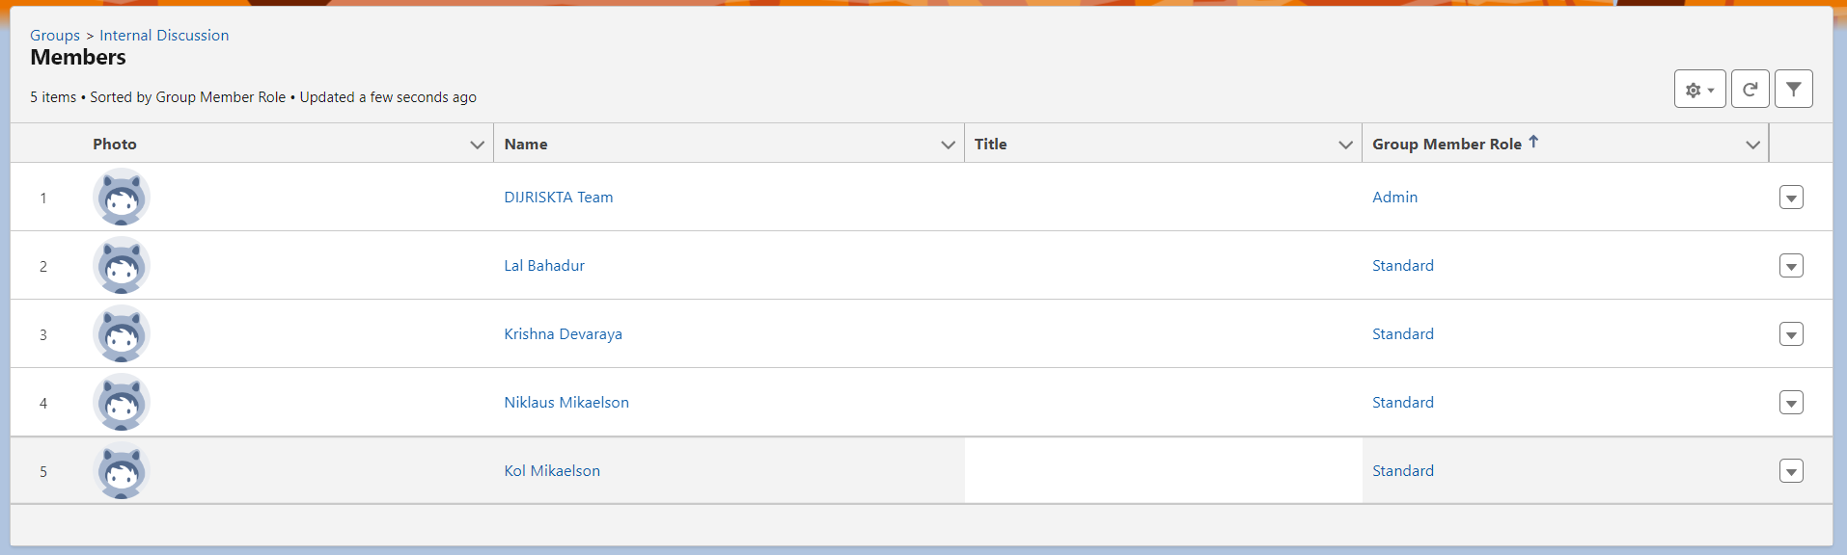
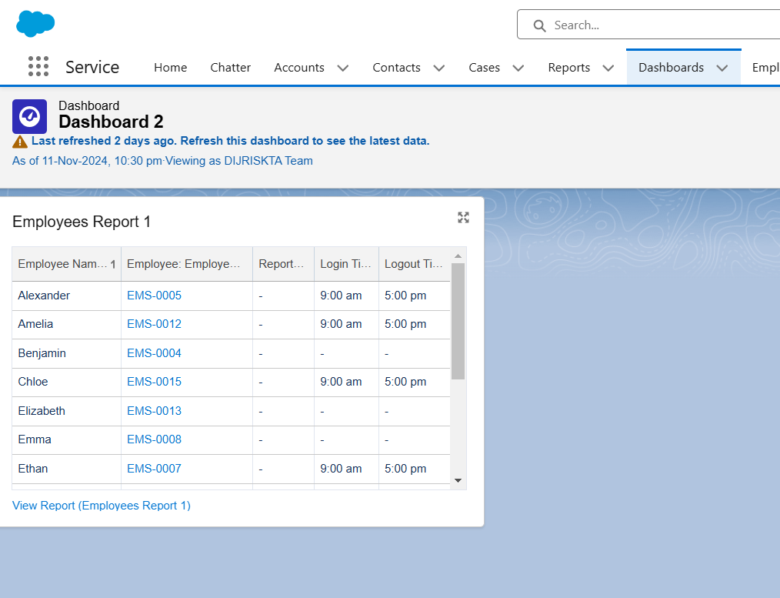
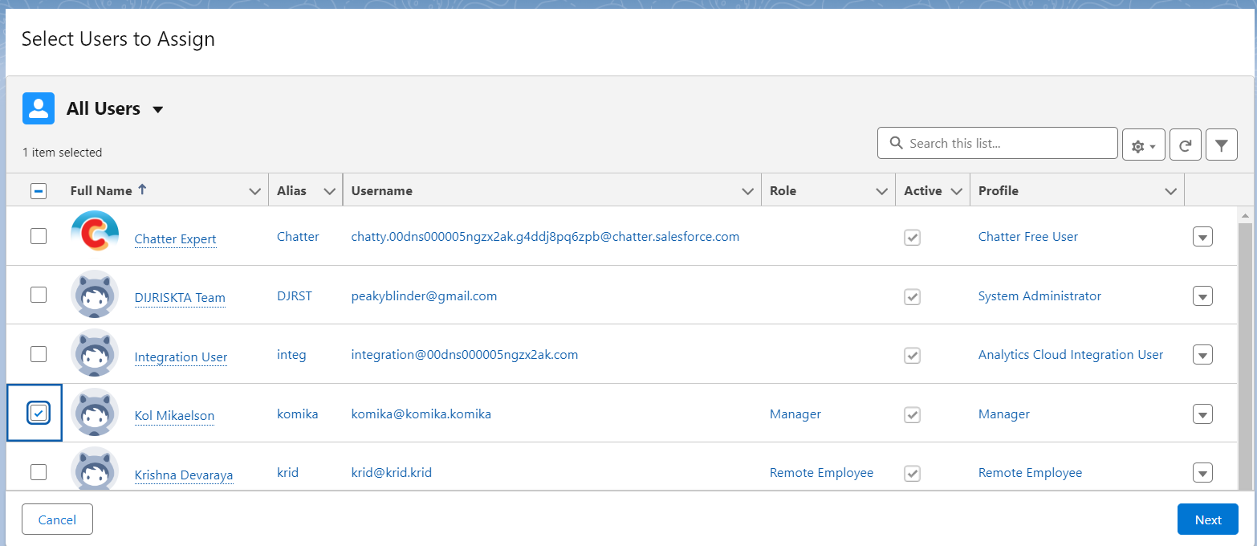
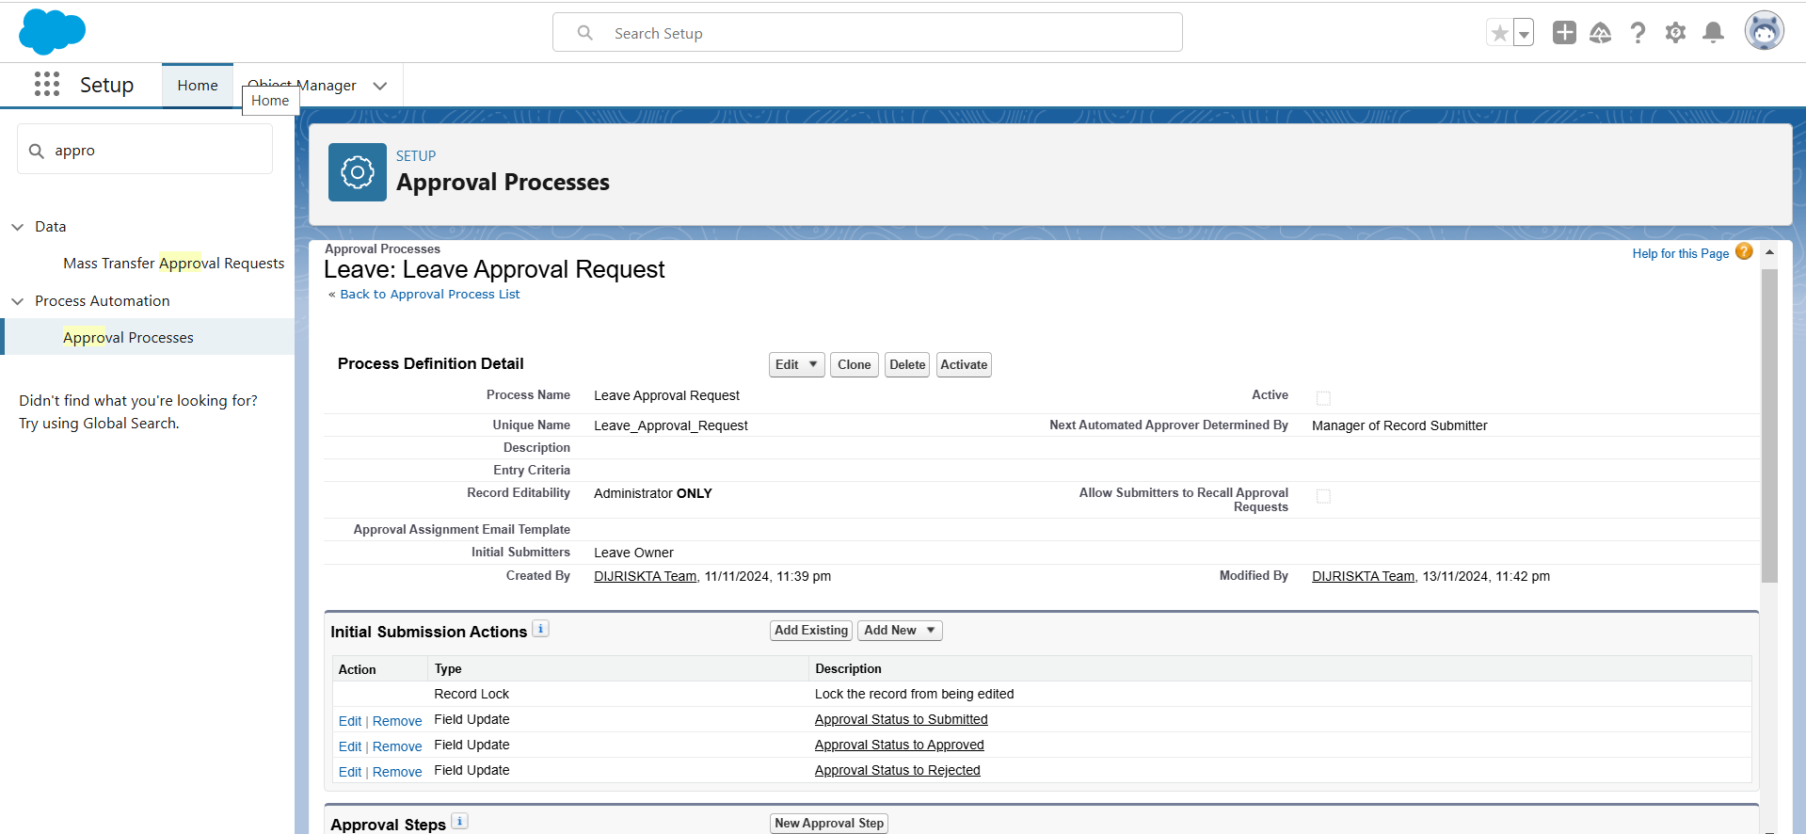
Dashboards
Chatter Groups
Permission set
Approval Process

Slide 15
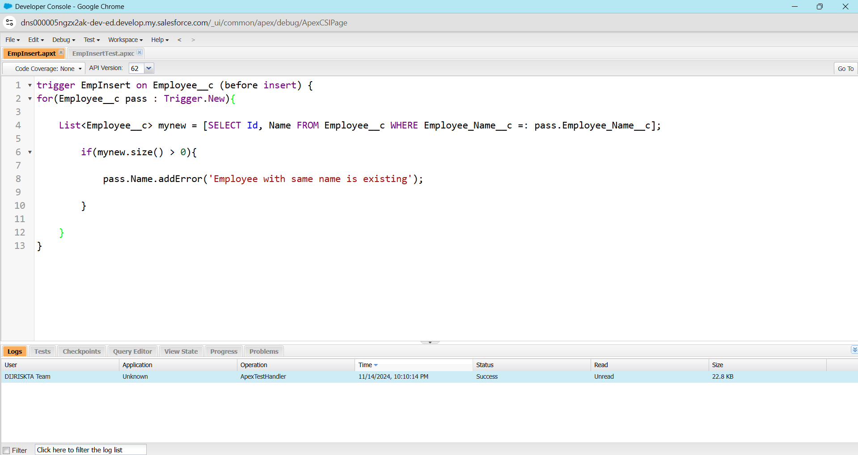
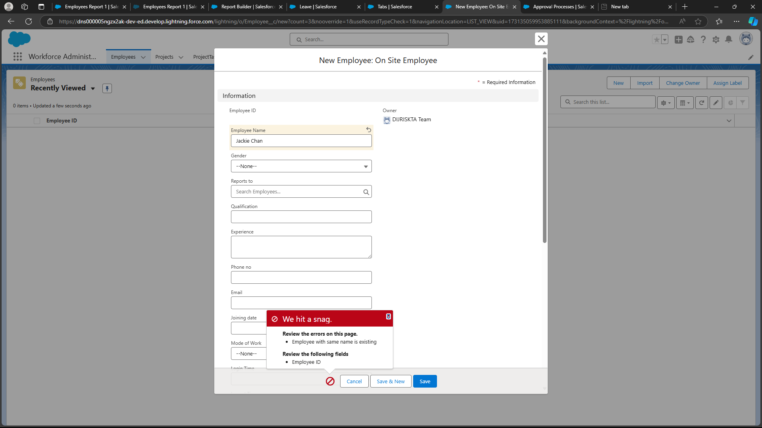
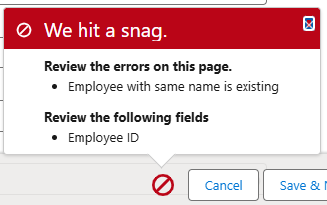
Output
ERROR:
Employee with same name is existing.

Slide 16
Conclusion
Workforce Administration Solution transforms organizational workflows, improves data security, and boosts productivity.
A scalable and robust platform that aligns with modern organizational needs.

Slide 17
ThankYou Github : DIJRISKTA-Team

